Slide 1
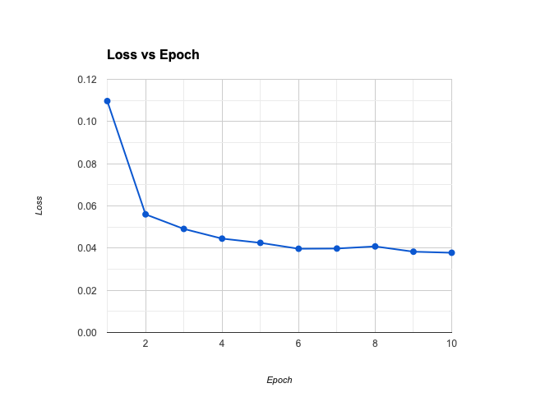
Training loss

Slide 2
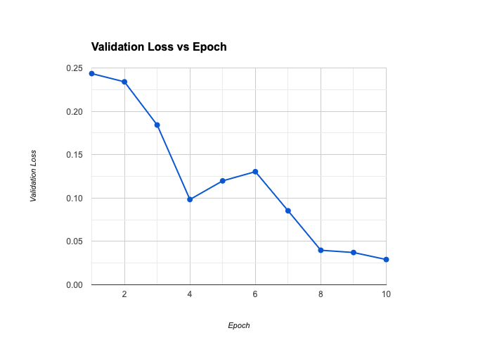
Validation loss

Slide 3
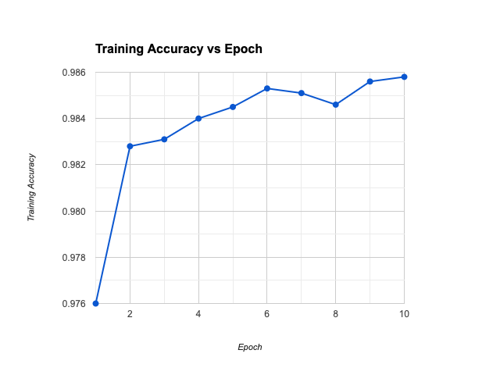
Training Accuracy

Slide 4
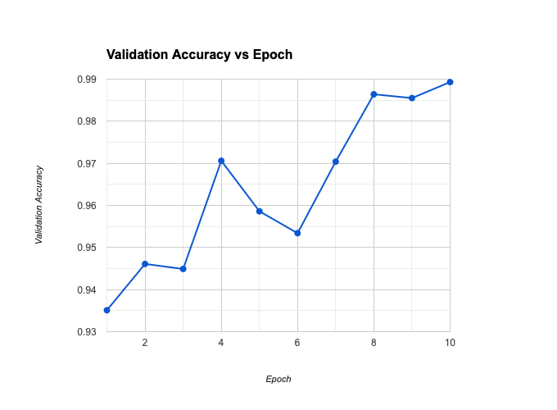
Validation Accuracy

Slide 5
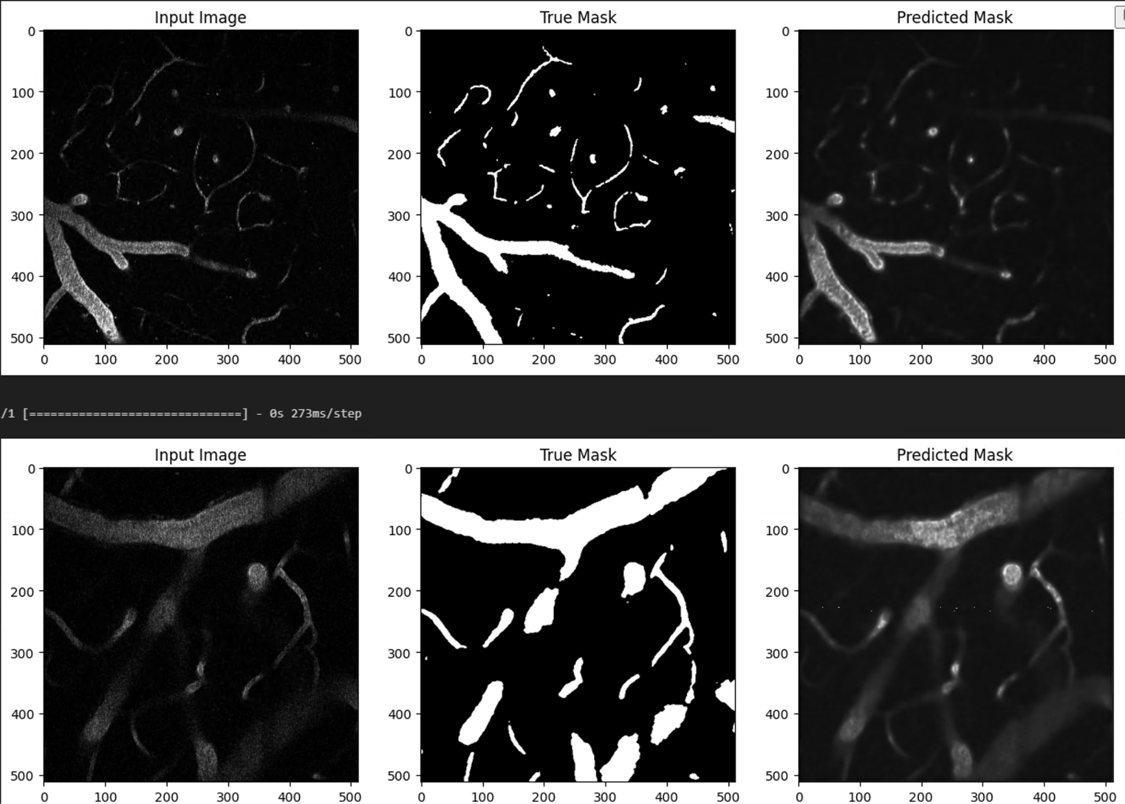
Sample Predictions

Slide 6

Sample Predictions

